Slide 1

Automatically Finding a Point Belonging to Stroke Region in MRI images
Student: Arūnas Butkus EKSfmu-16
Supervisor: doc. Dr. Andrius Ušinskas
2018

Slide 2
Key steps
To allow application of region growing algorithms for lesion delineation, certain steps need to be taken first:
Preprocessing MRI image to get more convenient data.
Getting a missing tissue probability map
Finding a point that is most likely to belong to the lesion region
Notes:
Mention use of SPM12
Explain getting f1
Explain variety of methods for getting the center

Slide 3
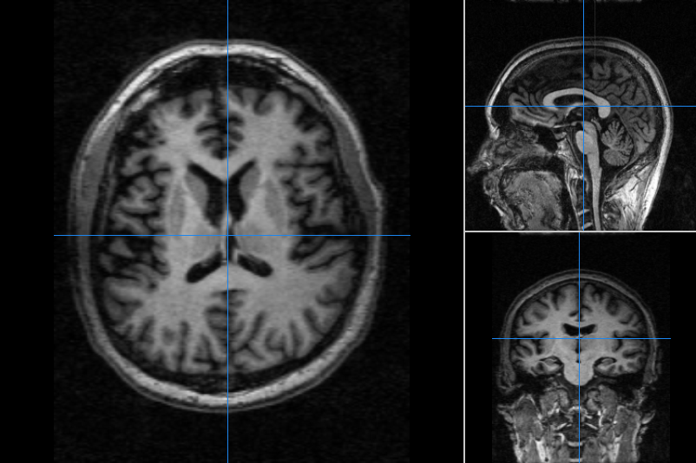
1. Preprocessing MRI image
Notes:
Show brain with difficult to discern lesion area

Slide 4
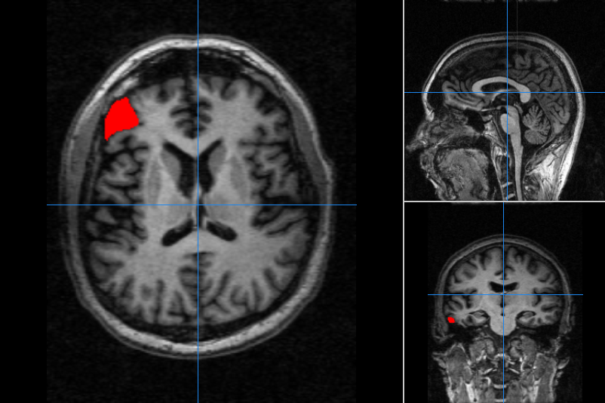
1. Preprocessing MRI image
Notes:
Show said lesion area

Slide 5
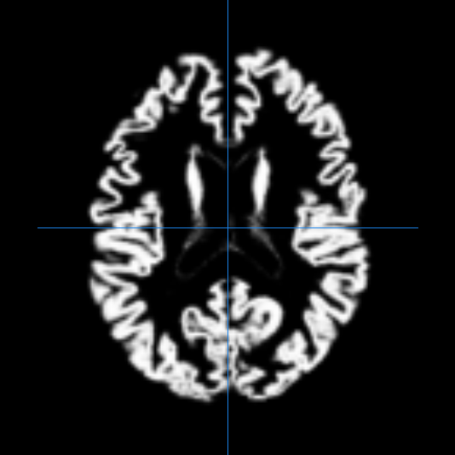
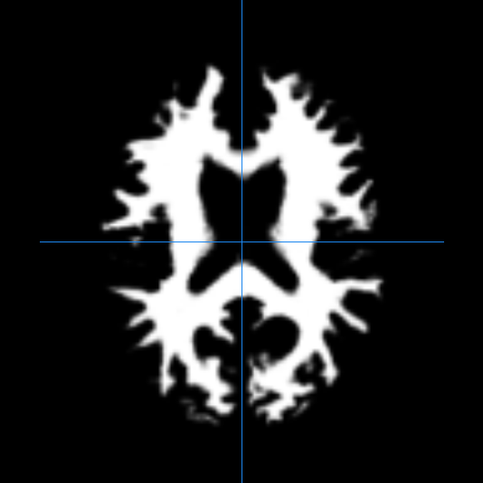
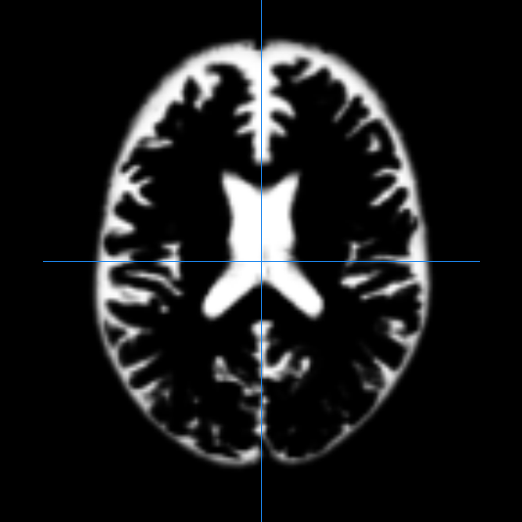
1. Preprocessing MRI image
Gray matter TPM
White matter TPM
Cerebro-spinal fluid TPM
SPM12 segmentation results

Slide 6
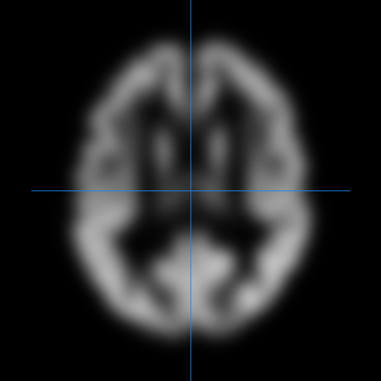
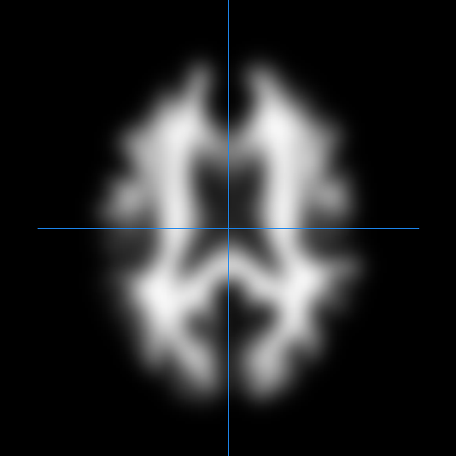
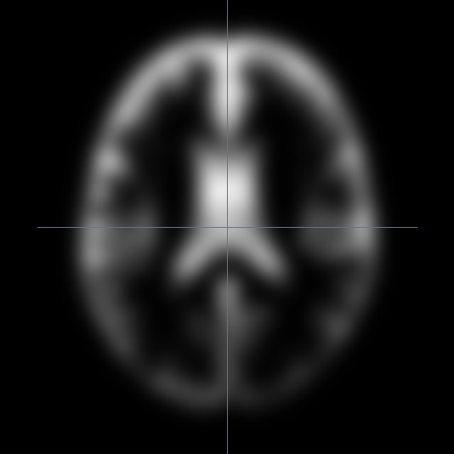
1. Preprocessing MRI image
Gray matter TPM
White matter TPM
Cerebro-spinal fluid TPM
SPM12 segmentation results with 11 voxel FWHM smoothing

Slide 7
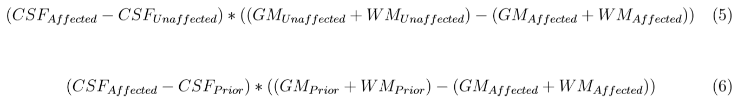
2. Getting a missing TPM

Slide 8
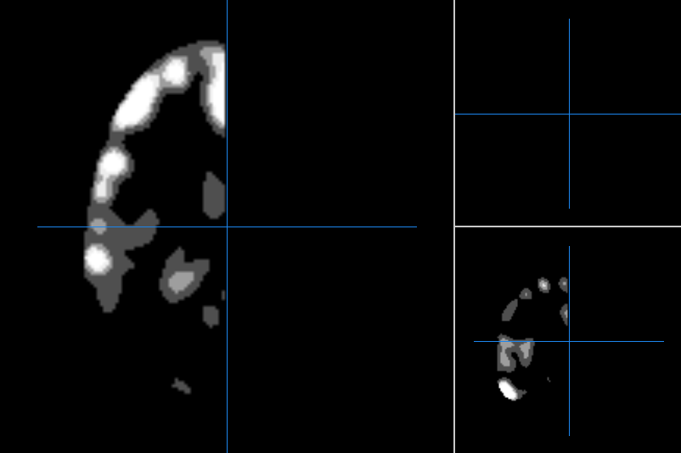
2. Getting a missing TPM

Slide 9
3. Finding lesion center
Geometric center using:
Manual threshold (GTC)
Weighted (GWTC)
Automatic threshold (GWATC)
3-dimensional maximum (mmmx)

Slide 10
3. Finding lesion center
Overall scores:
mmmx hit 89/113 [78.76%]
GTC >.5 hit 33/113 [29.20%]
GWTC >.5 hit 33/113 [29.20%]
GTC >.1 hit 76/113 [67.26%]
GWTC >.1 hit 77/113 [68.14%]
GWTC > 0 hit 17/113 [15.04%]
GWATC 75% hit 84/113 [74.34%]
GWATC 50% hit 77/113 [68.14%]
GWATC 25% hit 66/113 [58.41%]

Slide 11
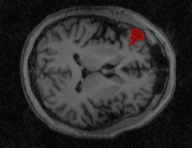
3. Finding lesion center

Slide 12
Results and discussions
Without predefined criteria, mmmx method has worked best in experiments. Defining few prerequisites could bring results close to 100%.
Additionally, other methods could be considered for lesion region center determination. Or even a different approach to getting lesion region itself, like post-processing missing tissue feature map.

Slide 13
Thank You, for Your attention
Vilnius, 2018

